Slide 1


Serverless: Cloud functions and the future of software architectures

Slide 2
Agenda
9:00am – Intro & Agenda
9:30am – Lesson 1
10:30am – 10 minute break
10:40am – Lesson 2
11:40am – 10 minute break
11:50am – Lesson 3
12:50pm – Lunch
1:40pm – Lesson 4
2:40pm – 10 minute break
2:50pm – Lesson 5 3:50pm – Wrap Up
4:00pm - Finish

Slide 3
Outcomes
A completely serverless video sharing web-site, complete with:
User authentication
Large file video uploads
A transcoding pipeline, that transcodes uploaded videos to web-friendly 480p mp4 format
Push-based, event-driven updates to the web-site. Users see new videos automatically, no browser refreshes needed
The ability to play video files hosted on scalable cloud storage.

Slide 4
Lesson Structure
Lesson 1 - Create a serverless transcoding pipeline in AWS
Lesson 2 - Setup the web site & user authentication (Auth0)
Lesson 3 - Create an API in the AWS cloud & authenticate calls
Lesson 4 - Enable browser-based uploads of video files to S3
Lesson 5 - Connect firebase to list videos
10 minute introduction 40 minutes practical work
10 minute debrief

Slide 5


Sam Kroonenburg
Peter Sbarski, PhD
Co-Founder & CTO
VP Engineering
A Cloud Guru
@samkroon
A Cloud Guru
@sbarski
Notes:
Sam
My name is Sam Kroonenburg and I’m the CTO & co-founder of an online social learning platform called A Cloud Guru. We’ve built our platform technology entirely serverless – in fact, we’re a completely serverless company. The only machines we run are our dev laptops.
I’ve been living in Melbourne, Australia, for the past 5 years, and prior to this I spent the majority of my career with Microsoft. I was a developer on the Windows team in Seattle, where I worked in the core file systems group. There my major focus was the Disk Defragmenter — which I owned, and had the honour of rewriting for Windows 7. I also worked on System Restore, Volume Shrink and the Volume Disk Service. I then worked for Microsoft in Oslo, Norway, on Microsoft’s next generation version of FAST Search.
So, when I talk about serverless architectures today — please know that I’m not anti-server — I’ve spent a large portion of my career building server software.
And then, this guy next to me with the bond villain accent is Pete...
Pete...
Hi everyone, my name is Peter Sbarski and I am VP of Engineering at A Cloud Guru. I have a background in computer science having received a PhD in Comp. Sci. back in 2008. Before joining A Cloud Guru I worked as a software development lead for a consultancy in Melbourne, Australia for about 5 years. I have also worked at the Defence Science and Technology Organisation and the UN in New York. I have an interest in cloud, software architecture, and the ever changing and crazy world of web technologies. At the moment my primary interest is serverless technologies on which I spend most of my time.

Slide 6
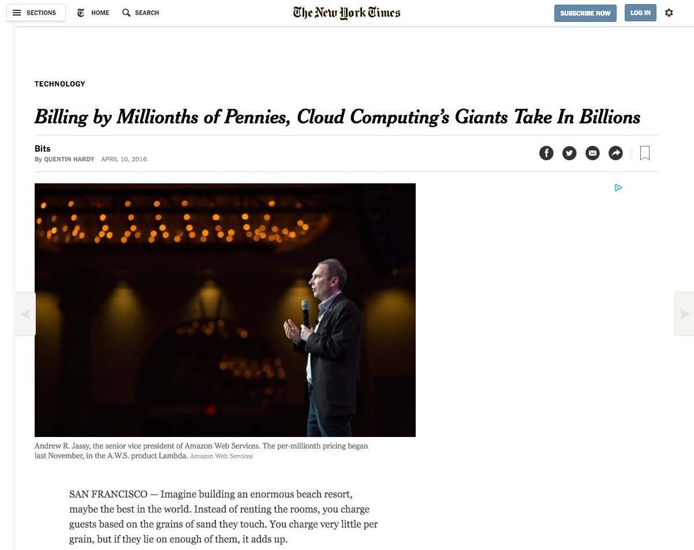

Serverless is blowing up right now
Notes:
Sam
There's a fundamental shift underway… the movement toward serverless cloud architectures is absolutely blowing up right now.
With the release of code-execution-as-a-service technologies such as AWS Lambda, IBM OpenWhisk, Azure Functions & Google Cloud Functions -- developers are now building entirely serverless platforms at scale. In these new architectures, traditional back-end servers are replaced with cloud functions acting as discrete single-purpose services.
Every major player in cloud is heavily investing in a serverless offering – everyone wants to lead the next generation of cloud technologies.
And the press is taking an interest – take a look at the NYT article from just a couple of days ago.

Slide 7

What is serverless?
Notes:
Pete
So before we go any further I think we need to define what serverless really means. We say that a system is serverless if it meets a simple rule:
- There aren’t any servers for you to run, manage or even access and,
- Your code runs in an ephemeral, scalable, stateless compute service such as AWS Lambda, IBM OpenWhisk, in an Azure Function or in a Google Cloud Functions.
- So, what are these serverless compute services? Let's take lambda as an example. You provide your code to lambda, in the form of a zip file... Your code is a single function... and lambda runs your code in response to an event. That might be you asking for it to be invoked, or a file being dropped into cloud storage, or an email being received.

Slide 8
Is it really serverless?
Vendor takes care of provisioning and management of servers.
Vendor is responsible for capacity provisioning and automated scaling.
Moving away from servers and infrastructure concerns should be your goal.
Notes:
Pete
By taking a compute service such as Lambda and making use of various powerful third-party APIs and web services, developers can build loosely coupled, scalable, and efficient architectures quickly. Moving away from servers and infrastructure concerns, as well as allowing the developer to primarily focus on code is the ultimate goal behind serverless.
Before we go any further we should mention that the word serverless is a bit of a misnomer. Whether you use a compute service such as AWS Lambda to execute your code or interact with an API, there are still servers running in the background. The difference is that these servers are hidden from us. There is no infrastructure for us to think about. No way to tweak the underlying operating system.
If, for example you use Lambda, AWS takes care of provisioning and management of the EC2 servers that actually execute your code. They are responsible for providing a redundant, high-available compute infrastructure—including capacity provisioning and automated scaling— that you, as a developer, do not need to think about. This frees our time to do other things such as solving the problem that is uniquely ours and moving quicker to overtake our competition.

Slide 9
A brief history of cloud
EC2 Launches
2006
Serverless
Data Centre
Containers
PAAS
IAAS
Notes:
Sam
So in approximately 2 minutes I’m going to summarise the entire history of cloud computing. Go with me.
OK, so a lot of devs (like me) don’t like computer hardware. It’s heavy, it’s cumbersome, it breaks. So we’ve spent decades building layer of abstraction over layer of abstraction in code, to shield ourselves from the ugly truth of what’s really running our code.
First, we decided – hey, let’s chuck this hardware in a data centre somewhere, and someone else can be responsible for making sure it’s turned on & connected to the network. Hooray, we no longer needed to get out of our chairs.
But provisioning this infrastructure wasn’t fun. We had to talk to people – calling or emailing the data centre provider. And it could take days to get access to new machines.
IAAS
And then, wham – 2006. Amazon releases EC2. And suddenly I can provision machines with API calls. From the command line. From my web browser. Heaven. IAAS was born, and developers around the world cheered. AWS is basically infrastructure as code. I can commission a machine anywhere in the world, and have it do my bidding with a single API call.
OK, so that’s great. Hats off to the AWS engineers — this is pretty cool.
But something has always has always bothered me about this Infrastructure-as-a-service model. I still have to worry about the infrastructure. I still know that it exists and something could go wrong at any moment. It’s ALWAYS in the back of my mind. What if it crashes? What if it gets owned?
PAAS
Microsoft Azure came out blazing with Platform-as-a-service (as did Amazon with Elastic Beanstalk), which was basically a nice way of saying — give me your code & we’ll spin up a machine for you, push your code onto it, and run it. Which is great, it’s one less step that I have to perform — but again. I still have a server that I can control, where things can go wrong — and that’s really my responsibility.
Containers
Containerization gained a lot of popularity in the past few years. Although not exclusively related to cloud, containers are popular in cloud environments. Containers are a lightweight alternative to full-blown virtualization. They are isolated and lightweight but they still need to be deployed to a server. They are an excellent solution when dependencies are in play but they have their own housekeeping challenges. You still have to worry about keeping your containers running, scaling in response to load, etc. They are still your responsibility.
Serverless
Serverless compute services like lambda take your code and run it without any need to provision servers, install software, deploy containers, or worry about low-level detail. And your code can be run in massively parallelized way in response to events. The cloud provider takes care of provisioning and management of the infrastructure and the dev doesn't need to think about it.

Slide 10
Did someone say microservices?
Microservices
Serverless
Notes:
PETE
So, a lot of people ask – isn’t this just microservices?
Well, no, but kinda.
The 2 are related… Microservices & serverless architectures are spiritual descendants of service-oriented architecture... And you can implement a microservices approach with serverless technologies… But you don’t have to.
Developers tend to think of microservices as small, standalone, fully independent services built around a particular business purpose.
Depending on how you design the system, every compute function could act as a standalone service, with it's own API & data storage. In fact, you could compose a microservice & API from multiple cloud functions.
However, you don’t need to fully embrace the microservices mantra. In fact, if you wanted to, you could compose a distributed monolithic application with a set of serverless cloud functions.
So the 2 are related, but not the same.

Slide 11

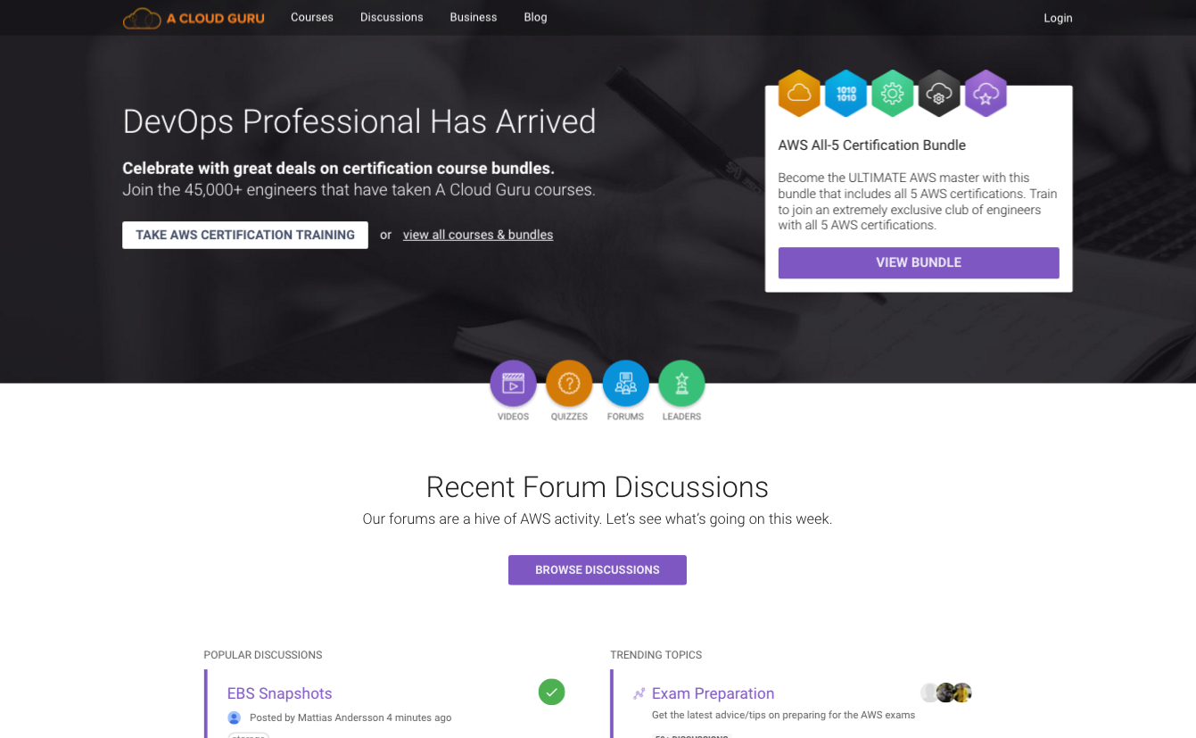
Notes:
Sam
So we want to tell you a little about our story, and what we’ve built. And we’ll use our own real-world examples walk you through what we think are the principles of serverless architecture.
So last year we put some courses on udemy.com teaching people about AWS, and helping them achieve their certifications.
The whole thing went a bit crazy & a lot of people seemed to like them. After a while we decided to build our own online training platform. We think learning is inherently social, and we had a vision to build the online training resource for AWS – with interactive discussions, gamification and lots of stuff to make training fun.

Slide 12
50,000+ engineers
Across 117 countries
Notes:
Sam
In 9 months, we’ve scaled to 50,000 engineers globally, across 117 counties.
At any given time there can be thousands of people using our platform – watching video courses, doing quizzes & interacting with each other via discussions in real time.
Our system is completely push based / event driven. That means that as people interact, those interactions are pushed immediately to all of the connected devices to the system. To people’s desktops, smartphones, tablets.

Slide 13
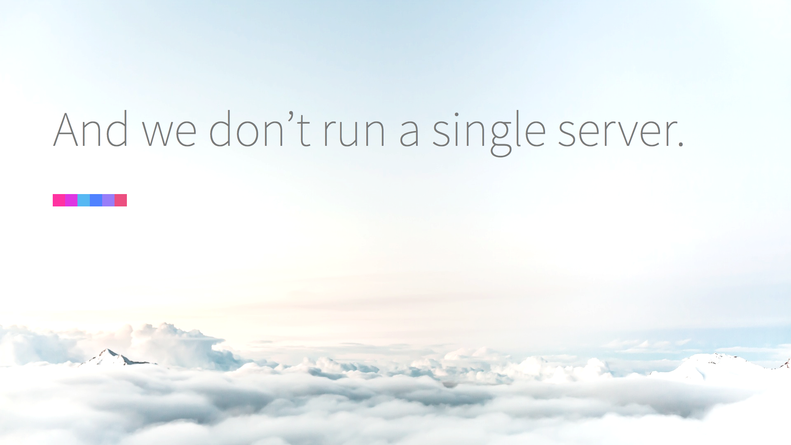
Notes:
Sam
And guess what?
We don’t run a single server.
Not one, anywhere. In fact, our hosting bill is almost non-existent, and we don't spend money on monitoring & maintenance of infrastructure.
To give you a little more context on what we've built, I need to show you our platform.

Slide 14
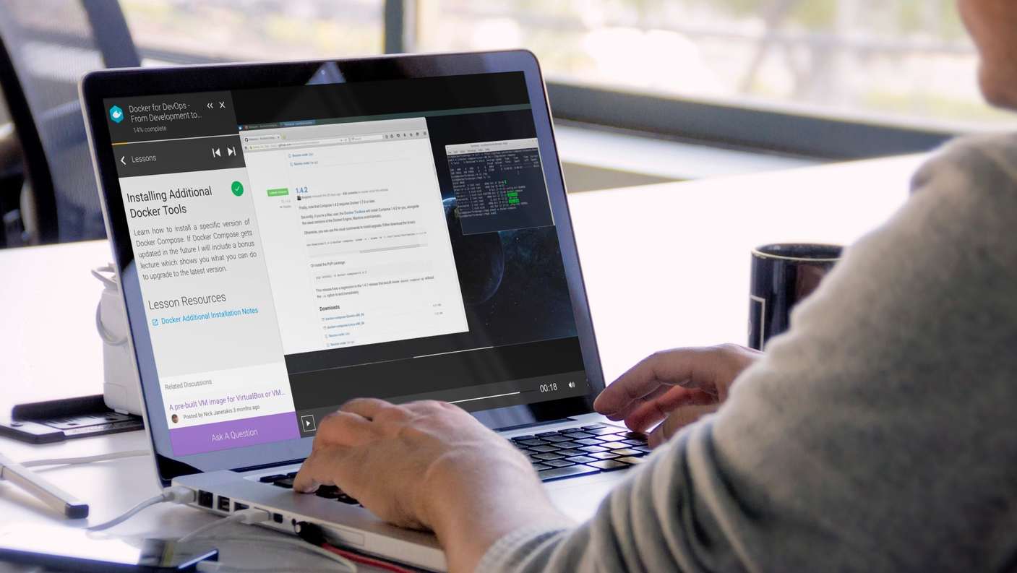
Notes:
Users can watch videos using our online web-based course viewer. They can do quizzes & practice exams.

Slide 15
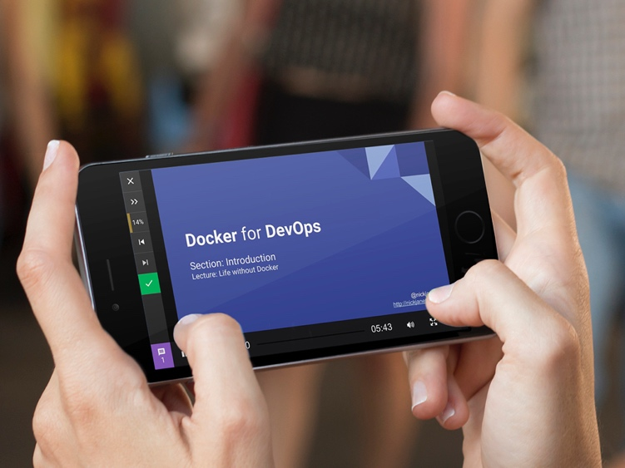
Notes:
Our web site is responsive and scales down nicely for both smartphones & tablets. We have touch support… a native app is in the works.

Slide 16
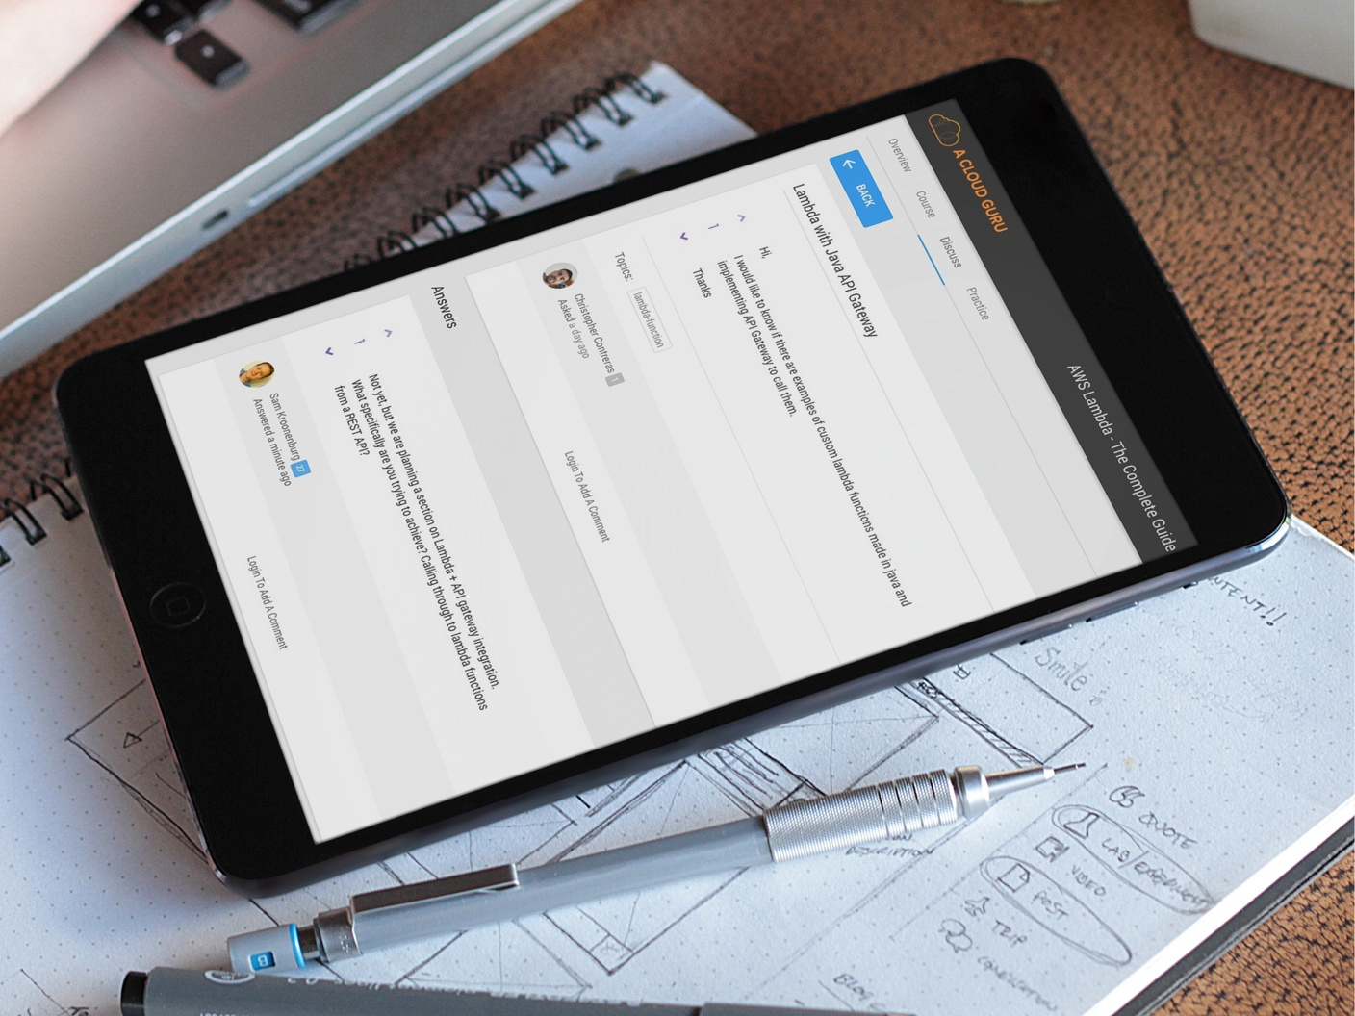
Notes:
We run our own discussion forums, which are integrated into the platform & the courses. People can ask questions, answer questions, vote answers up & down – stack overflow style. Users build reputation.

Slide 17
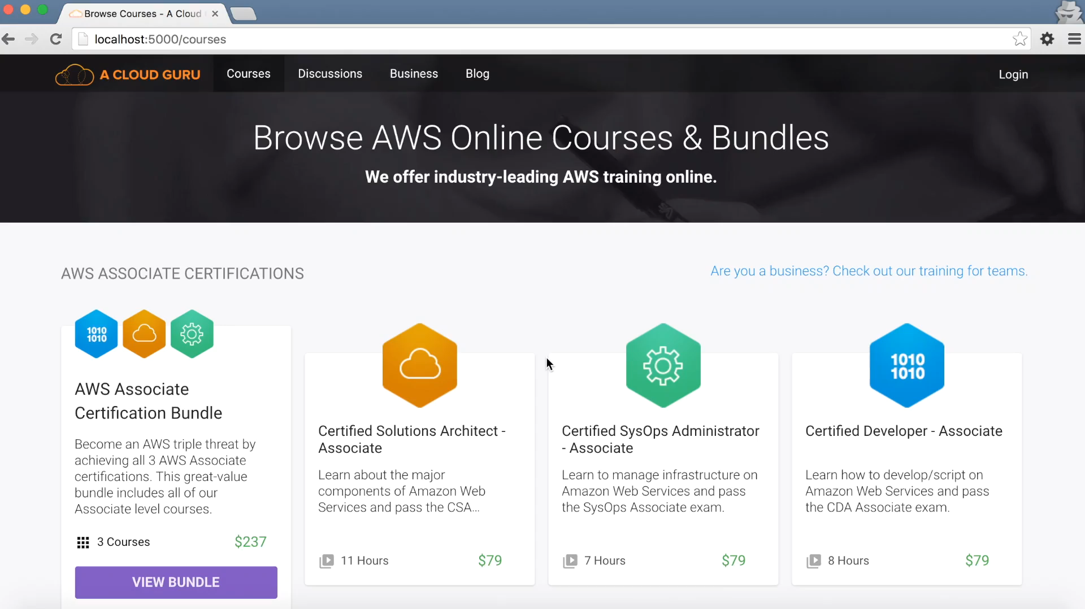
Notes:
Sam
So this isn’t something small scale & experimental… it’s a fully fledged, rich web application.
In fact, our ultimate aim is to build the online learning system of the future. We want to white-label the technology and allow people to create new schools on demand.
We’ve built a rich editing interface for instructors to edit courses, add lessons, upload videos, create quizzes.

Slide 18
Principles of Serverless Architecture
Use a compute service to execute code on demand
Write single-purpose stateless functions
Design push-based, event-driven pipelines
Create thicker, more powerful front ends
Embrace third party services
Illustrated with A Cloud Guru Examples
Notes:
Pete
Over the course of building A Cloud Guru and learning to really understand serverless technologies we came up with the 5 principles of serverless architectures. These principles are our attempt to describe serverless in a little more detail. It doesn’t mean that you need to follow all of these principles all of the time. However, if you are ever in doubt they are a good guide to building a serverless application.
So, let me tell you what they are right now and then we will explain how we applied each principle to building A Cloud Guru.
Principle 1: Use a compute service to execute code on demand (no servers)
Principle 2: Write single-purpose stateless functions
Principle 3: Design push-based, event-driven pipelines
Principle 4: Create thicker, more powerful front ends
Principle 5: Embrace third-party services

Slide 19
Workshop: Back End
Video Transcoder
Media Storage
Client
Custom API
Video List Database
Web Application
Notes:
Pete
Here’s a basic use cases where Lambda functions serve as a back end for a web or a mobile application. Our client application talks to Lambda functions via the API Gateway. As far as a client is aware, it is talking to a RESTful interface using HTTP. It doesn’t know that there are Lambda functions behind this RESTful interface and it doesn’t really need to know.
The Lambda runtime instantiates required Lambda functions for each request. Security is taken care of at the API Gateway or at each individual function. Our system can handle many simultaneous requests.
Every Lambda function connected to the API Gateway receives a request, does the required processing and returns a response via the API Gateway. Every Lambda function can invoke another Lambda function or another service. And, it doesn’t have to be an AWS service. We use Firebase as our primary user-facing database and our Lambda functions regularly talk to it.

Slide 20


Workshop: Transcoding Pipeline
Peter uploads a file
Source S3 Bucket
Lambda
Elastic Transcoder
Firebase (Database)
Lambda
Destination S3

